Slide 1
Vector Mechanics For Engineers: Dynamics Twelfth Edition
Copyright © 2020 McGraw Hill , All Rights Reserved.
PROPRIETARY MATERIAL © 2020 The McGraw Hill Inc. All rights reserved. No part of this PowerPoint slide may be displayed, reproduced or distributed in any form or by any means, without the prior written permission of the publisher, or used beyond the limited distribution to teachers and educators permitted by McGraw Hill for their individual course preparation. If you are a student using this PowerPoint slide, you are using it without permission.

Slide 2
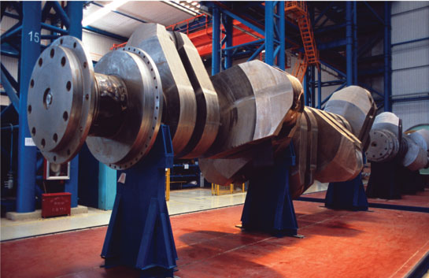
Chapter 15
Kinematics of Rigid Bodies

Slide 3
Contents
Introduction
Translation
Rotation About a Fixed Axis: Velocity
Rotation About a Fixed Axis: Acceleration
Rotation About a Fixed Axis: Representative Slab
Equations Defining the Rotation of a Rigid Body About a Fixed Axis
Sample Problem 15.3
Analyzing General Plane Motion
Absolute and Relative Velocity in Plane Motion
Sample Problem 15.6
Sample Problem 15.7
Instantaneous Center of Rotation
Sample Problem 15.9
Sample Problem 15.10
Absolute and Relative Acceleration in Plane Motion
Analysis of Plane Motion in Terms of a Parameter
Sample Problem 15.13
Sample Problem 15.15
Sample Problem 15.16
Rate of Change With Respect to a Rotating Frame
Plane Motion Relative to a Rotating Frame
Sample Problem 15.19
Sample Problem 15.20
Motion About a Fixed Point
General Motion
Sample Problem 15.21
Three Dimensional Motion Relative to a Rotating Frame
Frame of Reference in General Motion
Sample Problem 15.25

Slide 4
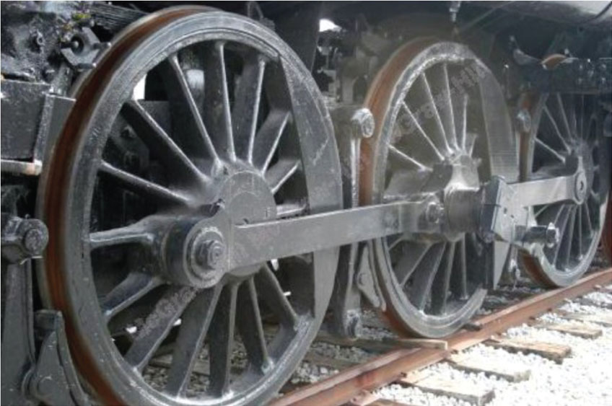
Applications 1
The linkage between train wheels is an example of curvilinear translation – the link stays horizontal as it swings through its motion.
©Alen penton / Alamy RF

Slide 5
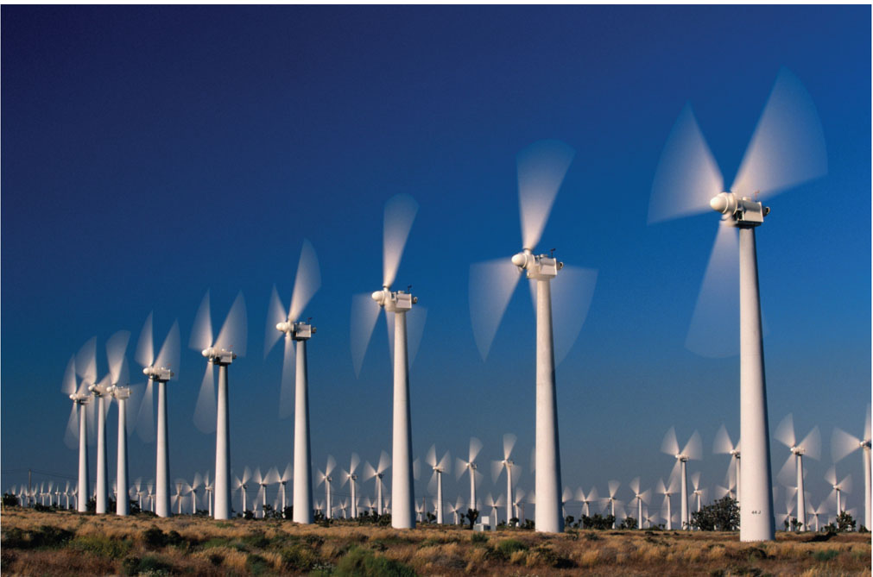
Applications 2
How can we determine the velocity of the tip of a turbine blade?
©Glen Allison / Getty Images RF

Slide 6
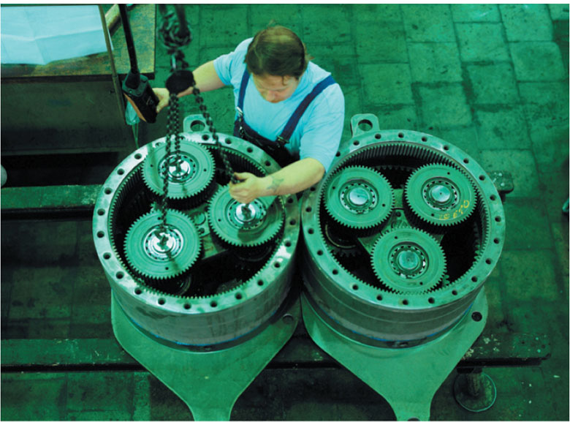
Applications 3
Planetary gear systems are used to get high reduction ratios with minimum weight and space. How can we design the correct gear ratios?
©Plus Pix / Agefotostock

Slide 7
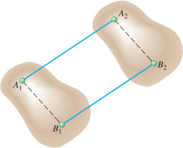
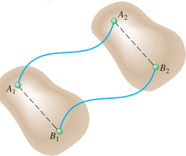
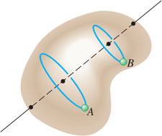
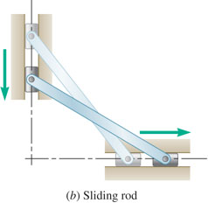
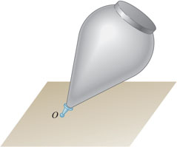
Introduction
Kinematics of rigid bodies: relations between time and the positions, velocities, and accelerations of the particles forming a rigid body.
Classification of rigid body motions:
translation:
rectilinear translation.
curvilinear translation.
rotation about a fixed axis.
general plane motion.
motion about a fixed point.
general motion.

Slide 8
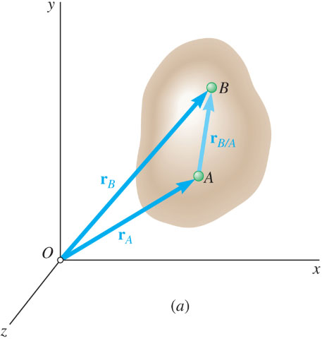
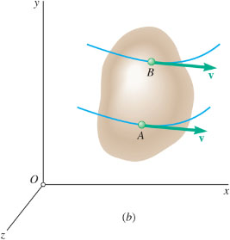
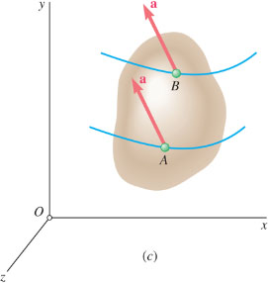
Translation
Consider rigid body in translation:
direction of any straight line inside the body is constant,
all particles forming the body move in parallel lines.
For any two particles in the body,
Differentiating with respect to time,
All particles have the same velocity.
Differentiating with respect to time again,
All particles have the same acceleration.

Slide 9
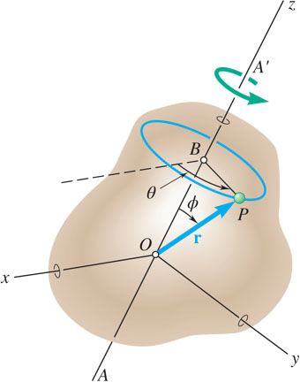
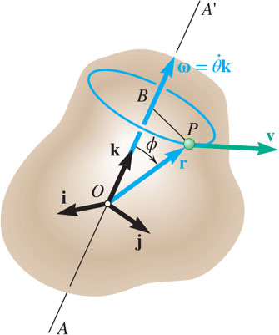
Rotation About a Fixed Axis. Velocity
Consider rotation of rigid body about a fixed axis AA’
Velocity vector
of the particle P
is tangent to the path with magnitude
The same result is obtained from

Slide 10
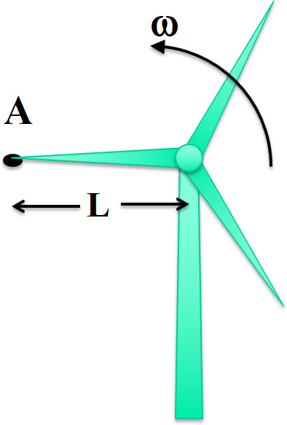
Concept Quiz 1
What is the direction of the velocity of point A on the turbine blade?
a)
b)
c)
d)
Notes:
Suggestions: First explain the direction of tangential velocity from a conceptual standpoint, then show the cross product. Can also discuss the velocity of other points on the blade. Ask students to set up the cross product, get the –j or downward direction.

Slide 11
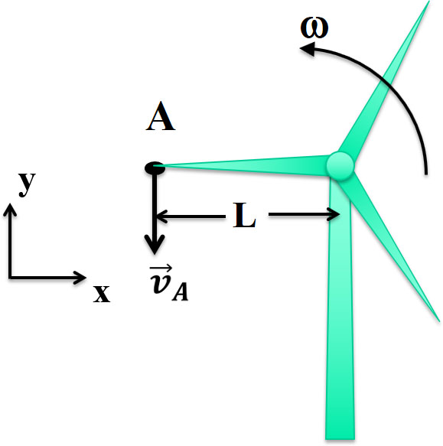
Concept Quiz 2
What is the direction of the velocity of point A on the turbine blade?
a)
b)
c)
d) Answer:
Notes:
Suggestions: First explain the direction of tangential velocity from a conceptual standpoint, then show the cross product. Can also discuss the velocity of other points on the blade. Ask students to set up the cross product, get the –j or downward direction.

Slide 12
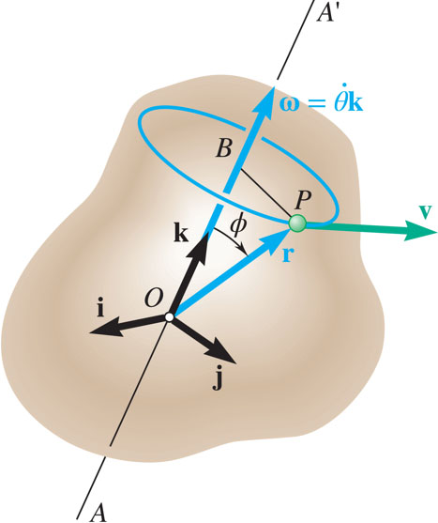
Rotation About a Fixed Axis. Acceleration 1
Differentiating to determine the acceleration,
Acceleration of P is combination of two vectors,

Slide 13
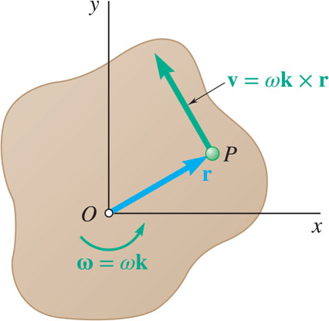
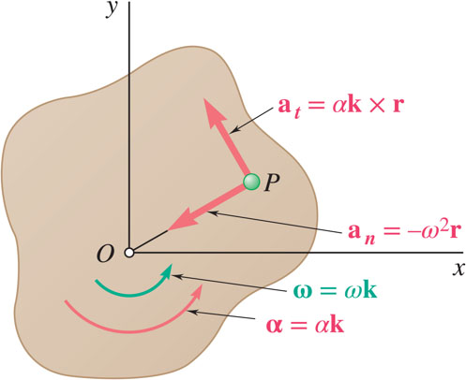
Rotation About a Fixed Axis. Representative Slab
Consider the motion of a representative slab in a plane perpendicular to the axis of rotation.
Velocity of any point P of the slab,
Acceleration of any point P of the slab,
Resolving the acceleration into tangential and normal components,

Slide 14
Concept Quiz 3
What is the direction of the normal acceleration of point A on the turbine blade?
a)
b)
c)
d)
Notes:
Suggestions: First explain the direction of tangential velocity from a conceptual standpoint, then show the cross product. Can also discuss the velocity of other points on the blade. Ask students to set up the cross product, get the –j or downward direction.

Slide 15
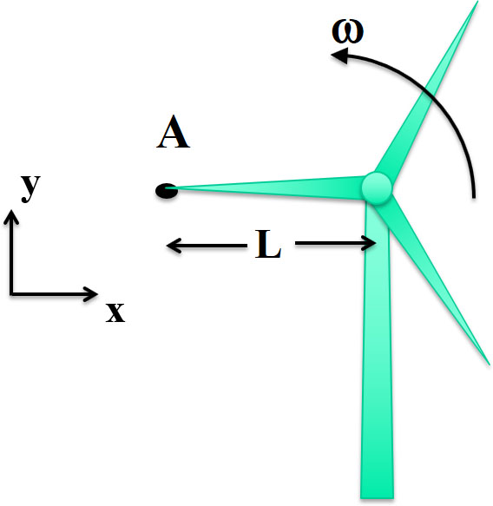
Concept Quiz 4
What is the direction of the normal acceleration of point A on the turbine blade?
a) Answer:
b)
c)
d)
Notes:
Suggestions: First explain the direction of tangential velocity from a conceptual standpoint, then show the cross product. Can also discuss the velocity of other points on the blade. Ask students to set up the cross product, get the –j or downward direction.

Slide 16

Equations Defining the Rotation of a Rigid Body About a Fixed Axis
Motion of a rigid body rotating around a fixed axis is often specified by the type of angular acceleration.
Recall
Uniform Rotation, α = 0:
Uniformly Accelerated Rotation, α = constant:

Slide 17
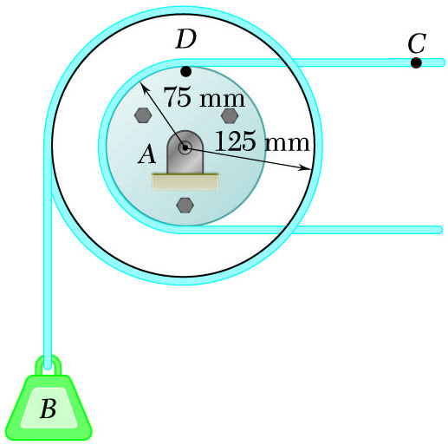
Sample Problem 15.3 1
Strategy:
Due to the action of the cable, the tangential velocity and acceleration of D are equal to the velocity and acceleration of C. Calculate the initial angular velocity and acceleration.
Apply the relations for uniformly accelerated rotation to determine the velocity and angular position of the pulley after 2 s.
Cable C has a constant acceleration of 225 mm/s² and an initial velocity of 300 mm/s, both directed to the right.
Determine (a) the number of revolutions of the pulley in 2 s, (b) the velocity and change in position of the load B after 2 s, and (c) the acceleration of the point D on the rim of the inner pulley at t = 0.
Evaluate the initial tangential and normal acceleration components of D.

Slide 18
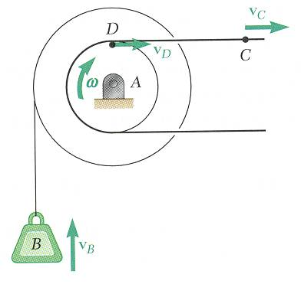
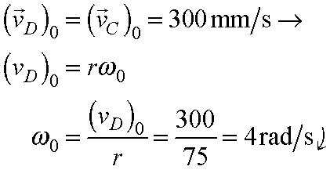
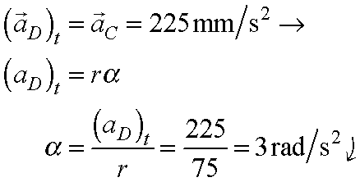
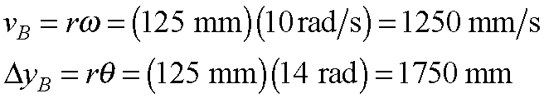
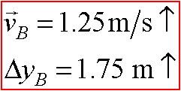
Sample Problem 15.3 2
Modeling and Analysis:
The tangential velocity and acceleration of D are equal to the velocity and acceleration of C.
Apply the relations for uniformly accelerated rotation to determine velocity and angular position of pulley after 2 s.

Slide 19
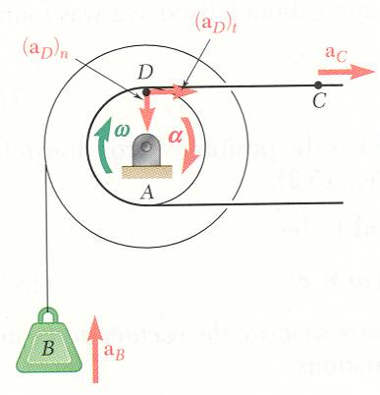
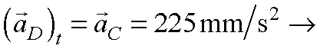
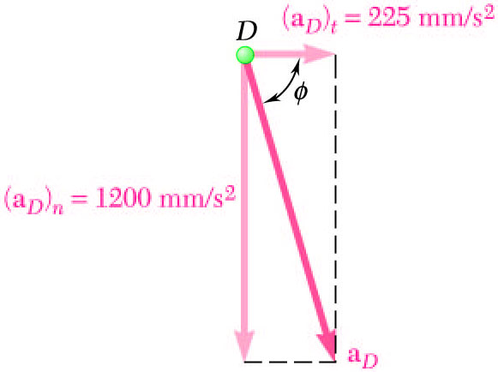
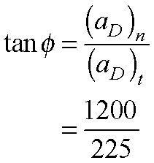
Sample Problem 15.3 3
Evaluate the initial tangential and normal acceleration components of D.
Magnitude and direction of the total acceleration,

Slide 20
Sample Problem 15.3 4
Reflect and Think:
A double pulley acts similarly to a system of gears; for every 75 mm that point C moves to the right, point B moves 125 mm upward. This is also similar to the rear tire of your bicycle. As you apply tension to the chain, the rear sprocket rotates a small amount, causing the rear wheel to rotate through a much larger angle.

Slide 21
Example – General Plane Motion
Planetary gear systems are used in applications requiring a large reduction ratio and a high torque-to-weight ratio. The small gears undergo general plane motion: the center of the gear is translating while the gear rotates about its center.
©Plus Pix / Agefotostock

Slide 22
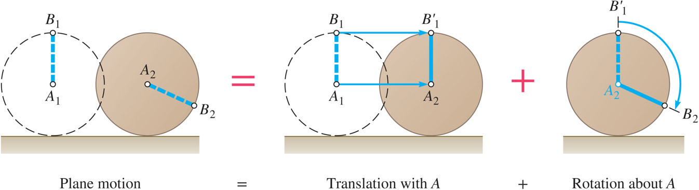
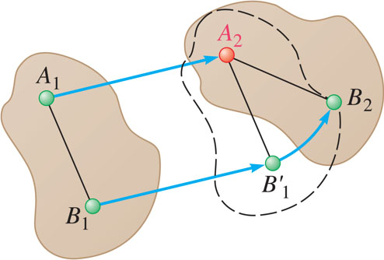
Analyzing General Plane Motion
General plane motion is neither a translation nor a rotation.
General plane motion can be considered as the sum of a translation and rotation.
Displacement of particles A and B to A₂ and B₂ can be divided into two parts:
translation to A₂ and
rotation of
about A₂ to B₂.

Slide 23
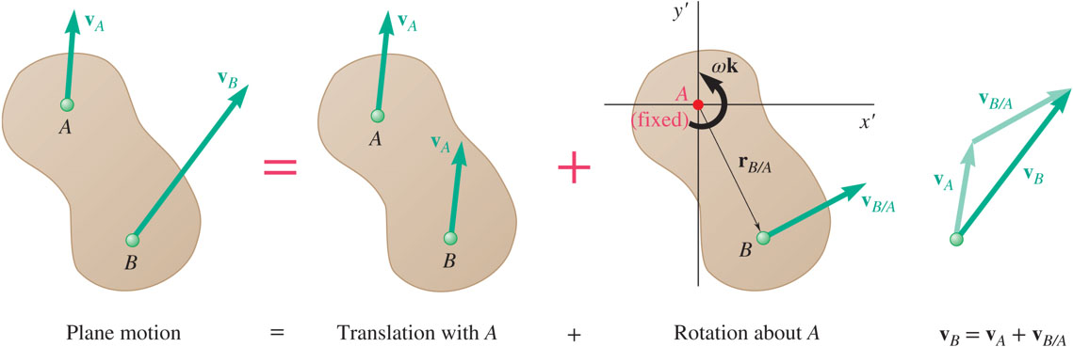
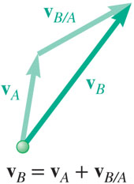
Absolute and Relative Velocity in Plane Motion 1
Any plane motion can be replaced by a translation of an arbitrary reference point A and a simultaneous rotation about A.

Slide 24
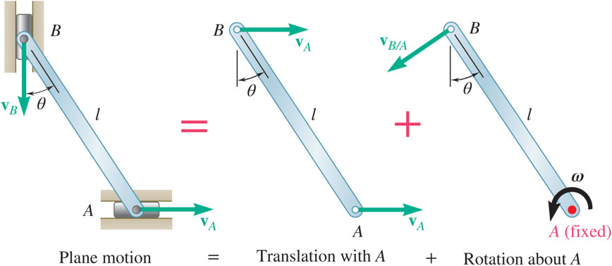
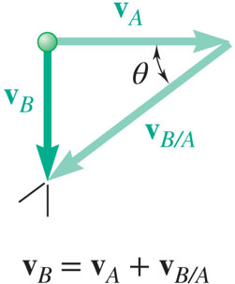
Absolute and Relative Velocity in Plane Motion 2
Assuming that the velocity v_{A} of end A is known, wish to determine the velocity v_{B} of end B and the angular velocity ω in terms of v_{A}, l, and θ.
The direction of v_{B} and v_{B/A} are known. Complete the velocity diagram.

Slide 25
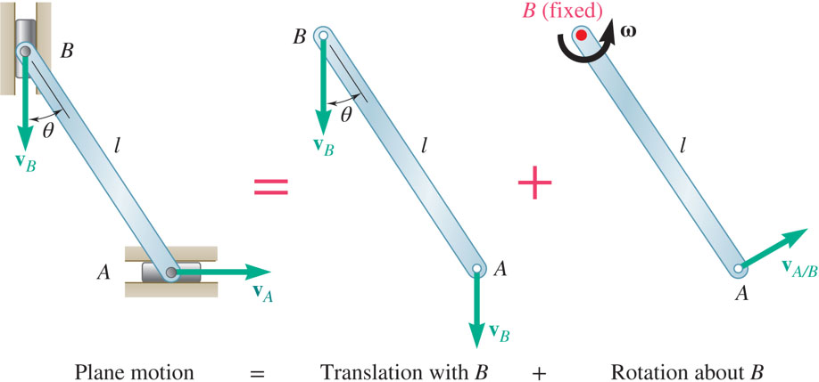
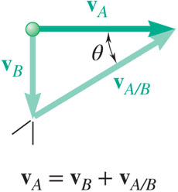
Absolute and Relative Velocity in Plane Motion 3
Selecting point B as the reference point and solving for the velocity v_{A} of end A and the angular velocity ω leads to an equivalent velocity triangle.
v_{A/B} has the same magnitude but opposite sense of v_{B/A}. The sense of the relative velocity is dependent on the choice of reference point.
Angular velocity ω of the rod in its rotation about B is the same as its rotation about A. Angular velocity is not dependent on the choice of reference point.

Slide 26
Absolute and Relative Velocity in Plane Motion 4
Assuming that the velocity v_{A} of end A is known, wish to determine the velocity v_{B} of end B and the angular velocity ω in terms of v_{A}, l, and θ.
The direction of v_{B} and v_{B/A} are known. Complete the velocity diagram.

Slide 27
Absolute and Relative Velocity in Plane Motion 5
Selecting point B as the reference point and solving for the velocity v_{A} of end A and the angular velocity ω leads to an equivalent velocity triangle.
v_{A/B} has the same magnitude but opposite sense of v_{B/A}. The sense of the relative velocity is dependent on the choice of reference point.
Angular velocity ω of the rod in its rotation about B is the same as its rotation about A. Angular velocity is not dependent on the choice of reference point.

Slide 28
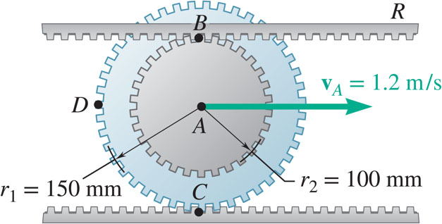
Sample Problem 15.6 1
Strategy:
The displacement of the gear center in one revolution is equal to the outer circumference. Relate the translational and angular displacements. Differentiate to relate the translational and angular velocities.
The double gear rolls on the stationary lower rack: the velocity of its center is 1.2 m/s.
Determine (a) the angular velocity of the gear, and (b) the velocities of the upper rack R and point D of the gear.
The velocity for any point P on the gear may be written as
Evaluate the velocities of points B and D.

Slide 29
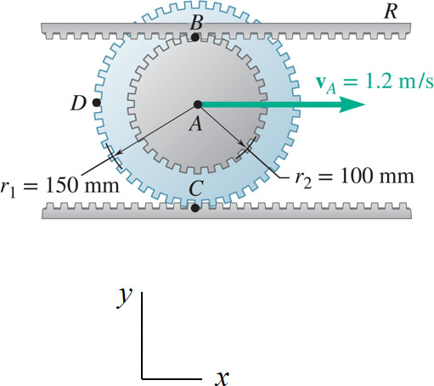
Sample Problem 15.6 2
Modeling and Analysis
The displacement of the gear center in one revolution is equal to the outer circumference.
For x_{A} > 0 (moves to right), ω < 0 (rotates clockwise).
Differentiate to relate the translational and angular velocities.

Slide 30
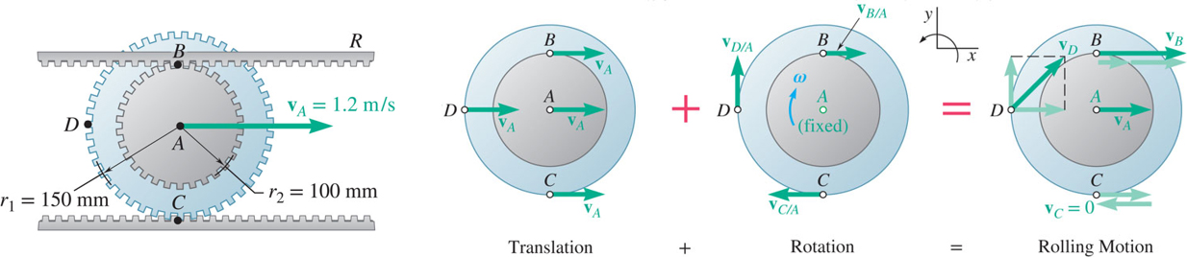
Sample Problem 15.6 3
For any point P on the gear,
Velocity of the upper rack is equal to velocity of point B:
Velocity of the point D:

Slide 31
Sample Problem 15.6 4
Reflect and Think:
Note that point A was free to translate, and Point C, since it is in contact with the fixed lower rack, has a velocity of zero. Every point along diameter CAB has a velocity vector directed to the right and the magnitude of the velocity increases linearly as the distance from point C increases.

Slide 32
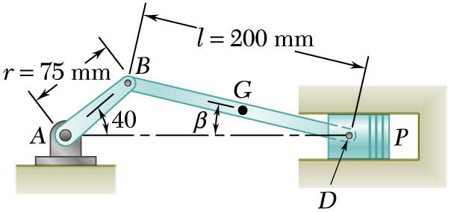
Sample Problem 15.7 1
Strategy:
Will determine the absolute velocity of point D with
The velocity is obtained from the given crank rotation data.
The crank AB has a constant clockwise angular velocity of 2000 rpm.
For the crank position indicated, determine (a) the angular velocity of the connecting rod BD, and (b) the velocity of the piston P.
The directions of the absolute velocity and the relative velocity are determined from the problem geometry.
The unknowns in the vector expression are the velocity magnitudes which may be determined from the corresponding vector triangle.
The angular velocity of the connecting rod is calculated from

Slide 33
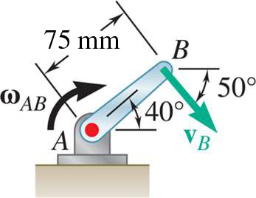
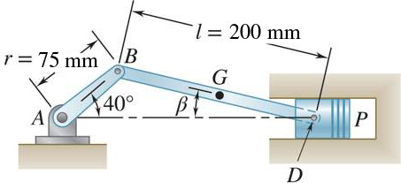
Sample Problem 15.7 2
Modeling and Analysis:
Will determine the absolute velocity of point D with,
is obtained from the crank rotation data.
The velocity
The velocity direction is as shown.
The direction of the absolute velocity
is horizontal. The direction of the relative velocity
is perpendicular to BD. Compute the angle between the horizontal and the connecting rod from the law of sines,

Slide 34
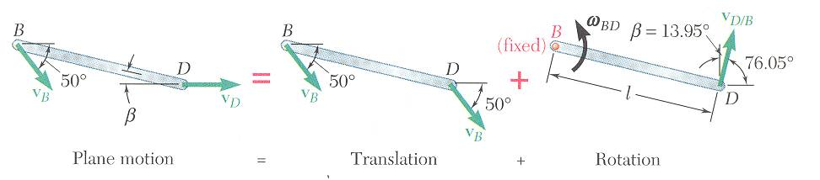
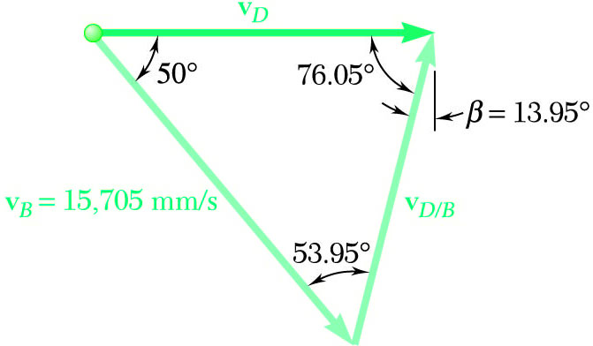
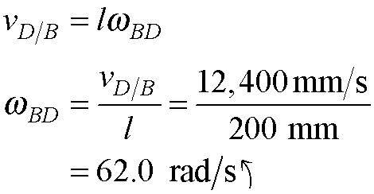
Sample Problem 15.7 3
Determine the velocity magnitudes from the vector triangle.

Slide 35
Sample Problem 15.7 4
Reflect and Think:
Note that as the crank continues to move
clockwise below the center line, the piston changes direction and starts to move to the left.
Can you see what happens to the motion of the connecting rod at that point?

Slide 36
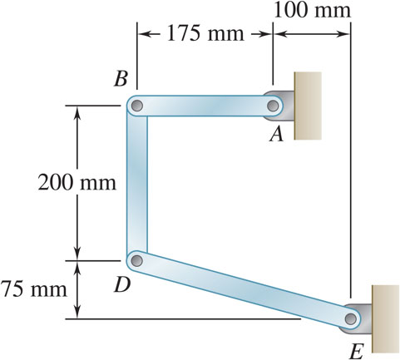
Concept Quiz 5
In the position shown, bar AB has an angular velocity of 10 rad/s clockwise.
Which of the following is true?
a) The direction of v_{B} is ↓
b) The direction of v_{D} is →
c) Both a) and b) are correct

Slide 37
Concept Quiz 6
In the position shown, bar AB has an angular velocity of 10 rad/s clockwise.
Which of the following is true?
a) Answer: The direction of v_{B} is ↓
b) The direction of v_{D} is →
c) Both a) and b) are correct

Slide 38

Group Problem Solving 1
Strategy:
The displacement of the gear center in one revolution is equal to the outer circumference. Relate the translational and angular displacements. Differentiate to relate the translational and angular velocities.
The velocity for any point P on the gear may be written as
In the position shown, bar AB has an angular velocity of 10 rad/s counterclockwise. Determine the angular velocity of bars BD and DE.
Evaluate the velocities of points B and D.

Slide 39
Group Problem Solving 2
Modeling and Analysis:
Determine the angular velocity of bars BD and DE.
How should you proceed?
Determine v_{B} with respect to A, then work your way along the linkage to point E.
Write v_{B} in terms of point A, calculate v_{B}.
Does it make sense that v_{B} is in the +j direction?

Slide 40
Group Problem Solving 3
Determine v_{D} with respect to B.
Determine v_{D} with respect to E, then equate it to equation above.
Equating components of the two expressions for v_{D}

Slide 41
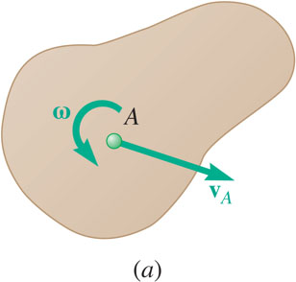
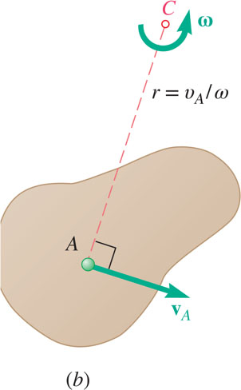
Instantaneous Center of Rotation 1
Plane motion of all particles in a slab can always be replaced by the translation of an arbitrary point A and a rotation about A with an angular velocity that is independent of the choice of A.
The same translational and rotational velocities at A are obtained by allowing the slab to rotate with the same angular velocity about the point C on a perpendicular to the velocity at A.
The velocity of all other particles in the slab are the same as originally defined since the angular velocity and translational velocity at A are equivalent.
As far as the velocities are concerned, the slab seems to rotate about the instantaneous center of rotation C.

Slide 42


Instantaneous Center of Rotation 2
If the velocity at two points A and B are known, the instantaneous center of rotation lies at the intersection of the perpendiculars to the velocity vectors through A and B .
If the velocity vectors are parallel, the instantaneous center of rotation is at infinity and the angular velocity is zero.
If the velocity vectors at A and B are perpendicular to the line AB, the instantaneous center of rotation lies at the intersection of the line AB with the line joining the extremities of the velocity vectors at A and B.
If the velocity magnitudes are equal, the instantaneous center of rotation is at infinity and the angular velocity is zero.

Slide 43


Instantaneous Center of Rotation 3
The instantaneous center of rotation lies at the intersection of the perpendiculars to the velocity vectors through A and B.
The velocities of all particles on the rod are as if they were rotated about C.
The particle at the center of rotation has zero velocity.
The particle coinciding with the center of rotation changes with time and the acceleration of the particle at the instantaneous center of rotation is not zero.
The acceleration of the particles in the slab cannot be determined as if the slab were simply rotating about C.
The trace of the locus of the center of rotation on the body is the body centrode and in space is the space centrode.

Slide 44
Instantaneous Center of Rotation 4
At the instant shown, what is the approximate direction of the velocity of point G, the center of bar AB?
a)
b)
c)
d)

Slide 45
Instantaneous Center of Rotation 5
At the instant shown, what is the approximate direction of the velocity of point G, the center of bar AB?
a)
b)
c) Answer:
d)

Slide 46
Sample Problem 15.9 1
Strategy:
The point C is in contact with the stationary lower rack and, instantaneously, has zero velocity. It must be the location of the instantaneous center of rotation.
Determine the angular velocity about C based on the given velocity at A.
The double gear rolls on the stationary lower rack: the velocity of its center is 1.2 m/s.
Determine (a) the angular velocity of the gear, and (b) the velocities of the upper rack R and point D of the gear.
Evaluate the velocities at B and D based on their rotation about C.

Slide 47


Sample Problem 15.9 2
Modeling and Analysis:
The point C is in contact with the stationary lower rack and, instantaneously, has zero velocity. It must be the location of the instantaneous center of rotation.
Determine the angular velocity about C based on the given velocity at A.
Evaluate the velocities at B and D based on their rotation about C.
Reflect and Think:
The results are the same as in Sample Prob. 15.6, as you would expect, but it took much less computation to get them

Slide 48

Sample Problem 15.10 1
Strategy:
Determine the velocity at B from the given crank rotation data.
The direction of the velocity vectors at B and D are known. The instantaneous center of rotation is at the intersection of the perpendiculars to the velocities through B and D.
The crank AB has a constant clockwise angular velocity of 2000 rpm.
For the crank position indicated, determine (a) the angular velocity of the connecting rod BD, and (b) the velocity of the piston P.
Use method of instantaneous center of rotation
Determine the angular velocity about the center of rotation based on the velocity at B.
Calculate the velocity at D based on its rotation about the instantaneous center of rotation.

Slide 49



Sample Problem 15.10 2
Modeling and Analysis:
From Sample Problem 15.3,
The instantaneous center of rotation is at the intersection of the perpendiculars to the velocities through B and D.
Determine the angular velocity about the center of rotation based on the velocity at B.
Calculate the velocity at D based on its rotation about the instantaneous center of rotation.

Slide 50
Instantaneous Center of Zero Velocity
Reflect and Think:
What happens to the location of the instantaneous center of velocity if the crankshaft angular velocity increases from 2000 rpm in the previous problem to 3000 rpm?
What happens to the location of the instantaneous center of velocity if the angle β is 0?

Slide 51

Absolute and Relative Acceleration in Plane Motion 1
If the central gear speeds up, a point on one of the linkages will undergo acceleration because of the linear motion of the linkage, the angular acceleration of the point attached to the central gear, and the normal acceleration of the point attached to the central gear.
©Lawrence manning / Corbis RF

Slide 52


Absolute and Relative Acceleration in Plane Motion 2
Absolute acceleration of a particle of the slab,
Relative acceleration
associated with rotation about A includes tangential and normal components.

Slide 53





Absolute and Relative Acceleration in Plane Motion 3
Given
determine
Vector result depends on sense of
and the relative magnitudes of
Must also know angular velocity ω.

Slide 54
Absolute and Relative Acceleration in Plane Motion 4
Write
in terms of the two component equations,
x components:
y components:
Solve for a_{B} and α.

Slide 55

Analysis of Plane Motion in Terms of a Parameter
In some cases, it is advantageous to determine the absolute velocity and acceleration of a mechanism directly.

Slide 56
Concept Question 1
You have made it to the kickball championship game. As you try to kick home the winning run, your mind naturally drifts towards dynamics. Which of your following thoughts is TRUE, and causes you to shank the ball horribly straight to the pitcher?
A) Energy will not be conserved when I kick this ball
B) In general, the linear acceleration of my knee is equal to the linear acceleration of my foot C) Throughout the kick, my foot will only have tangential acceleration. D) In general, the angular velocity of the upper leg (thigh) will be the same as the angular velocity of the lower leg

Slide 57
Concept Question 2
You have made it to the kickball championship game. As you try to kick home the winning run, your mind naturally drifts towards dynamics. Which of your following thoughts is TRUE, and causes you to shank the ball horribly straight to the pitcher?
A) Answer: Energy will not be conserved when I kick this ball
B) In general, the linear acceleration of my knee is equal to the linear acceleration of my foot C) Throughout the kick, my foot will only have tangential acceleration. D) In general, the angular velocity of the upper leg (thigh) will be the same as the angular velocity of the lower leg

Slide 58
Sample Problem 15.13 1
Strategy:
The expression of the gear position as a function of θ is differentiated twice to define the relationship between the translational and angular accelerations.
The acceleration of each point on the gear is obtained by adding the acceleration of the gear center and the relative accelerations with respect to the center. The latter includes normal and tangential acceleration components.
The center of the double gear has a velocity and acceleration to the right of 1.2 m/s and
respectively. The lower rack is stationary.
Determine (a) the angular acceleration of the gear, and (b) the acceleration of points B, C, and D.

Slide 59
Sample Problem 15.13 2
Modeling and Analysis:
The expression of the gear position as a function of θ is differentiated twice to define the relationship between the translational and angular accelerations.

Slide 60


Sample Problem 15.13 3
The acceleration of each point is obtained by adding the acceleration of the gear center and the relative accelerations with respect to the center.
The latter includes normal and tangential acceleration components.

Slide 61


Sample Problem 15.13 4

Slide 62
Sample Problem 15.13 5
Reflect and Think:
It is interesting to note that the x-component of acceleration for point C is zero since it is in direct contact with the fixed lower rack. It does, however, have a normal acceleration pointed upward. This is also true for a wheel rolling without slip.

Slide 63

Sample Problem 15.15 1
Strategy:
The angular acceleration of the connecting rod BD and the acceleration of point D will be determined from
The acceleration of B is determined from the given rotation speed of AB.
Crank AG of the engine system has a constant clockwise angular velocity of 2000 rpm.
For the crank position shown, determine the angular acceleration of the connecting rod BD and the acceleration of point D.
The directions of the accelerations are determined from the geometry.
Component equations for acceleration of point D are solved simultaneously for acceleration of D and angular acceleration of the connecting rod.

Slide 64



Sample Problem 15.15 2
Modeling and Analysis:
The angular acceleration of the connecting rod BD and the acceleration of point D will be determined from
The acceleration of B is determined from the given rotation speed of AB.

Slide 65




Sample Problem 15.15 3
The directions of the accelerations are determined from the geometry.
From Sample Problem 15.3, ω_{BD} = 62.0 rad/s, β = 13.95º.
The direction of (a_{D/B})_{t} is known but the sense is not known,

Slide 66



Sample Problem 15.15 4
Component equations for acceleration of point D are solved simultaneously.
x components:
y components:

Slide 67


Sample Problem 15.15 5
Reflect and Think:
In this solution, you looked at the magnitude and direction of each term ($\overset{⃑}{a_{B}}$ and $\overset{⃑}{a_{D/B}}$) and then found the x and y components.
Alternatively, you could have assumed that $\overset{⃑}{a_{D}}$ was to the left, $\overset{⃑}{α_{BD}}$ was positive, and then substituted in the vector quantities to get:
$$\overset{⃑}{a_{D}}=\overset{⃑}{a_{B}}+α\overset{⃑}{k}×\overset{⃑}{r_{D/B}}−ω^{2}\overset{⃑}{r_{D/B}}$$
These produce These identical expressions for the i and j components compared to the previous equations if you substitute in the numbers.

Slide 68

Sample Problem 15.16 1
Strategy:
The angular velocities are determined by simultaneously solving the component equations for
The angular accelerations are determined by simultaneously solving the component equations for
In the position shown, crank AB has a constant angular velocity ω₁ = 20 rad/s counterclockwise.
Determine the angular velocities and angular accelerations of the connecting rod BD and crank DE.

Slide 69






Sample Problem 15.16 2
Modeling and Analysis:
The angular velocities are determined by simultaneously solving the component equations for
x components:
y components:

Slide 70







Sample Problem 15.16 3
The angular accelerations are determined by simultaneously solving the component equations for
x components:
y components:

Slide 71
Concept Quiz 7
Knowing that at the instant shown bar AB has a constant angular velocity of 10 rad/s clockwise, determine the angular acceleration of bars BD and DE.
Which of the following is true?
a) The direction of a_{D} is
b) The angular acceleration of BD must also be constant
c) The direction of the linear acceleration of B is

Slide 72
Concept Quiz 8
Knowing that at the instant shown bar AB has a constant angular velocity of 10 rad/s clockwise, determine the angular acceleration of bars BD and DE.
Which of the following is true?
a) The direction of a_{D} is
b) The angular acceleration of BD must also be constant
c) Answer: The direction of the linear acceleration of B is

Slide 73
Group Problem Solving 4
Strategy:
The angular velocities were determined in a previous problem by simultaneously solving the component equations for,
The angular accelerations are now determined by simultaneously solving the component equations for the relative acceleration equation.
Knowing that at the instant shown bar AB has a constant angular velocity of 4 rad/s clockwise, determine the angular acceleration of bars BD and DE.

Slide 74
Group Problem Solving 5
Modeling and Analysis:
From our previous problem, we used the relative velocity equations to find that:
We can now apply the relative acceleration equation with
Analyze Bar AB
Analyze Bar BD

Slide 75
Group Problem Solving 6
Analyze Bar DE
From previous page, we had:
Equate like components of a_{D}
j:
i:

Slide 76

Concept Question 3
If the clockwise angular velocity of crankshaft AB is constant, which of the following statement is true?
a) The angular velocity of BD is constant
b) The linear acceleration of point B is zero
c) The angular velocity of BD is counterclockwise
d) The linear acceleration of point B is tangent to the path

Slide 77
Concept Question 4
If the clockwise angular velocity of crankshaft AB is constant, which of the following statement is true?
a) The angular velocity of BD is constant
b) The linear acceleration of point B is zero
c) Answer: The angular velocity of BD is counterclockwise
d) The linear acceleration of point B is tangent to the path

Slide 78

Applications 4
Rotating coordinate systems are often used to analyze mechanisms (such as amusement park rides) as well as weather patterns.
©Stock trek/ Getty Images RF

Slide 79

Rate of Change With Respect to a Rotating Frame
With respect to the rotating Oxyz frame,
With respect to the fixed OXYZ frame,
rate of change with respect to rotating frame.
Frame OXYZ is fixed.
If
were fixed within Oxyz then
Frame Oxyz rotates about fixed axis OA with angular velocity.
is equivalent to velocity of a point in a rigid body attached to Oxyz and
Vector function
varies in direction and magnitude.
With respect to the fixed OXYZ frame,

Slide 80


Plane Motion Relative to a Rotating Frame 1
Frame OXY is fixed and frame Oxy rotates with angular velocity
Position vector
for the particle P is the same in both frames but the rate of change depends on the choice of frame.
The absolute velocity of the particle P is,
Imagine a rigid slab attached to the rotating frame Oxy or F for short. Let P′ be a point on the slab which corresponds instantaneously to position of particle P.
velocity of P along its path on the slab
absolute velocity of point P′ on the slab
Absolute velocity for the particle P may be written as

Slide 81
Plane Motion Relative to a Rotating Frame 2
Absolute acceleration for the particle P is,
but,
Utilizing the conceptual point P’ on the slab,
Absolute acceleration for the particle P becomes,
Coriolis acceleration

Slide 82

Plane Motion Relative to a Rotating Frame 3
Consider a collar P which is made to slide at constant relative velocity u along rod OB. The rod is rotating at a constant angular velocity ω. The point A on the rod corresponds to the instantaneous position of P.
Absolute acceleration of the collar is,
where
The absolute acceleration consists of the radial and tangential vectors shown.

Slide 83


Plane Motion Relative to a Rotating Frame 4
Change in velocity over Δt is represented by the sum of three vectors
is due to change in direction of the velocity of point A on the rod,
Recall,
result from combined effects of relative motion of P and rotation of the rod
recall,

Slide 84

Concept Question 5
You are walking with a constant velocity with respect to the platform, which rotates with a constant angular velocity w. At the instant shown, in which direction(s) will you experience an acceleration (choose all that apply)?
a) +x
b) −x
c) +y
d) −y
e) Acceleration = 0

Slide 85

Concept Question 6
You are walking with a constant velocity with respect to the platform, which rotates with a constant angular velocity w. At the instant shown, in which direction(s) will you experience an acceleration (choose all that apply)?
a) +x
b) −x
c) +y
d) −y
e) Acceleration = 0

Slide 86

Sample Problem 15.19 1
Strategy:
The absolute velocity of the point P may be written as
Magnitude and direction of velocity
of pin P are calculated from the radius and angular velocity of disk D.
Disk D of the Geneva mechanism rotates with constant counterclockwise angular velocity ω_{D} = 10 rad/s.
At the instant when φ = 150º, determine (a) the angular velocity of disk S, and (b) the velocity of pin P relative to disk S.
Direction of velocity
of point P’ on S coinciding with P is perpendicular to radius OP.
of P with respect to S is parallel to the slot.
Direction of velocity
Solve the vector triangle for the angular velocity of S and relative velocity of P.

Slide 87


Sample Problem 15.19 2
Modeling and Analysis:
The absolute velocity of the point P may be written as,
Magnitude and direction of absolute velocity of pin P are calculated from radius and angular velocity of disk D.
Direction of velocity of P with respect to S is parallel to slot. From the law of cosines,
From the law of cosines,
The interior angle of the vector triangle is

Slide 88
Sample Problem 15.19 3
Direction of velocity of point P’ on S coinciding with P is perpendicular to radius OP. From the velocity triangle,
Reflect and Think: The result of the Geneva mechanism is that disk S rotates ¼ turn each time pin P engages, then it remains motionless while pin P rotates around before entering the next slot. Disk D rotates continuously, but disk S rotates intermittently. An alternative approach to drawing the vector triangle is to use vector algebra.

Slide 89
Sample Problem 15.19 4
Strategy:
The absolute acceleration of the pin P may be expressed as,
The instantaneous angular velocity of Disk S is determined as in Sample Problem 15.9.
The only unknown involved in the acceleration equation is the instantaneous angular acceleration of Disk S.
In the Geneva mechanism, disk D rotates with a constant counter-clockwise angular velocity of 10 rad/s. At the instant when ϕ = 150º, determine angular acceleration of disk S.
The only unknown involved in the acceleration equation is the instantaneous angular acceleration of Disk S.
Resolve each acceleration term into the component parallel to the slot. Solve for the angular acceleration of Disk S.

Slide 90

Sample Problem 15.19 5
Modeling and Analysis:
The absolute acceleration of the pin P may be expressed as
From Sample Problem 15.9.
Considering each term in the acceleration equation,
note: α_{S} may be positive or negative

Slide 91
Sample Problem 15.19 6
The direction of the Coriolis acceleration is obtained by rotating the direction of the relative velocity
by 90º in the sense of ω_{S.}
The relative acceleration
must be parallel to the slot.
Equating components of the acceleration terms perpendicular to the slot,

Slide 92
Sample Problem 15.20
Reflect and Think:
It seems reasonable that, since disk S starts and stops over the very short time intervals when pin P is engaged in the slots, the disk must have a very large angular acceleration. An alternative approach would have been to use the vector algebra approach.

Slide 93



Motion About a Fixed Point
The most general displacement of a rigid body with a fixed point O is equivalent to a rotation of the body about an axis through O.
With the instantaneous axis of rotation and angular velocity
the velocity of a particle P of the body is
and the acceleration of the particle P is
The angular acceleration
represents the velocity of the tip of
As the vector
moves within the body and in space, it generates a body cone and space cone which are tangent along the instantaneous axis of rotation.
Angular velocities have magnitude and direction and obey parallelogram law of addition. They are vectors.

Slide 94

General Motion
For particles A and B of a rigid body,
Particle A is fixed within the body and motion of the body relative to AX′Y′Z′ is the motion of a body with a fixed point
Similarly, the acceleration of the particle P is
Most general motion of a rigid body is equivalent to:
a translation in which all particles have the same velocity and acceleration of a reference particle A, and
of a motion in which particle A is assumed fixed.

Slide 95

Concept Question 7
The figure depicts a model of a caster wheel. If both ω₁ and ω₂ are constant, what is true about the angular acceleration of the wheel?
a) It is zero.
b) It is in the +x direction
c) It is in the +z direction
d) It is in the −x direction
e) It is in the −z direction

Slide 96
Concept Question 8
The figure depicts a model of a caster wheel. If both ω₁ and ω₂ are constant, what is true about the angular acceleration of the wheel?
a) It is zero.
b) Answer: It is in the +x direction
c) It is in the +z direction
d) It is in the −x direction
e) It is in the −z direction

Slide 97

Sample Problem 15.21 1
Strategy:
With
Angular velocity of the boom,
The crane rotates with a constant angular velocity ω₁ = 0.30 rad/s and the boom is being raised with a constant angular velocity ω₂ = 0.50 rad/s. The length of the boom is l = 12 m.
Angular acceleration of the boom,
Determine:
angular velocity of the boom,
angular acceleration of the boom,
velocity of the boom tip, and
acceleration of the boom tip.
Velocity of boom tip,
Acceleration of boom tip,

Slide 98


Sample Problem 15.21 2
Modeling and Analysis:
Angular velocity of the boom,
Angular acceleration of the boom,
Velocity of boom tip,

Slide 99
Sample Problem 15.21 3
Acceleration of boom tip,
Reflect and Think:
The base of the cab acts as the fixed point of the motion. Even though both components of angular velocity are constant, there is an angular acceleration due to the change in direction of the angular velocity ω₂. The angular velocity vector ω₂ changes due to the rotation of the cab, ω₁.

Slide 100


Three-Dimensional Motion Relative to a Rotating Frame
Given a vector function
with respect to the fixed frame OXYZ and rotating frame Oxyz,
Consider motion of particle P relative to a rotating frame Oxyz or F for short. The absolute velocity can be expressed as
The absolute acceleration can be expressed as

Slide 101

Frame of Reference in General Motion
With respect to OXYZ and AX′Y′Z′,
The velocity and acceleration of P relative to AX′Y′Z′ can be found in terms of the velocity and acceleration of P relative to Axyz.
Consider:
fixed frame OXYZ,
translating frame AX’Y’Z’, and
translating and rotating frame Axyz or F.

Slide 102

Sample Problem 15.25
Strategy:
Define a fixed reference frame OXYZ at O and a moving reference frame Axyz or F attached to the arm at A.
With P′ of the moving reference frame coinciding with P, the velocity of the point P is found from
For the disk mounted on the arm, the indicated angular rotation rates are constant.
The acceleration of P is found from
Determine:
the velocity of the point P,
the acceleration of P, and
angular velocity and angular acceleration of the disk.
The angular velocity and angular acceleration of the disk are

Slide 103

Sample Problem 15.25 1
Modeling and Analysis:
Define a fixed reference frame OXYZ at O and a moving reference frame Axyz or F attached to the arm at A.
With P’ of the moving reference frame coinciding with P, the velocity of the point P is found from

Slide 104
Sample Problem 15.25 2
The acceleration of P is found from
Angular velocity and acceleration of the disk,

Slide 105
Sample Problem 15.25 3
Reflect and Think:
Knowing the absolute angular velocity of the disk is equal to
you could have determined the velocity of P by attaching the rotating axes to the disk and using

Slide 106

Group Problem Solving 7
The crane shown rotates at the constant rate ω₁= 0.25 rad/s; simultaneously, the telescoping boom is being lowered at the constant rate ω₂= 0.40 rad/s. Knowing that at the instant shown the length of the boom is 6 m and is increasing at the constant rate u= 0.5 m/s determine the acceleration of Point B.
Strategy:
Define a moving reference frame Axyz or F attached to the arm at A.
The acceleration of B is found from
The angular velocity and angular acceleration of the disk are

Slide 107


Group Problem Solving 8
Modeling and Analysis:
Given: ω₁= 0.25 rad/s, ω₂= -0.40 rad/s. L= 6 m, u = 0.5 m/s
Find: a_{B}.
Equation of overall acceleration of B
Do any of the terms go to zero?
Let the unextending portion of the boom AB be a rotating frame of reference. What are

Slide 108

Group Problem Solving 9
Determine the position vector r_{B/A}
Find
Find

Slide 109
Group Problem Solving 10
Determine the Coriolis acceleration – first define the relative velocity term
Calculate the Coriolis acceleration
Add the terms together

Slide 110
End of Chapter 15

